Slide 1

Building Compilers
With
MLIR
An intro
Mehdi Amini - NVIDIA Cambridge “summer” School - 9/8/2025

Slide 2
Agenda
What’s a compiler?
What’s MLIR and why?
Core MLIR concepts
MLIR in practice:
Play with the C++ API: Traverse the IR, print what we can.
Write a pass:
Understand the scheduling
Mutate the IR
Debugging
Diagnostics and remarks

Slide 3

Start by cloning: https://github.com/joker-eph/playing-with-mlir
git clone git@github.com:joker-eph/playing-with-mlir.git
Pull the container:
docker pull jokereph/mlir-tutorial:debug

Slide 4
Large number of public talks
LLVM Dev Meeting 2020: MLIR Tutorial [ Video ] [ Slides ]
Lot more content, 89 technical talks from our public meetings: https://mlir.llvm.org/talks/
Very active community: 25 out of 54 talks about MLIR at EuroLLVM 2023! https://www.youtube.com/@LLVMPROJ/search?query=MLIR

Slide 5
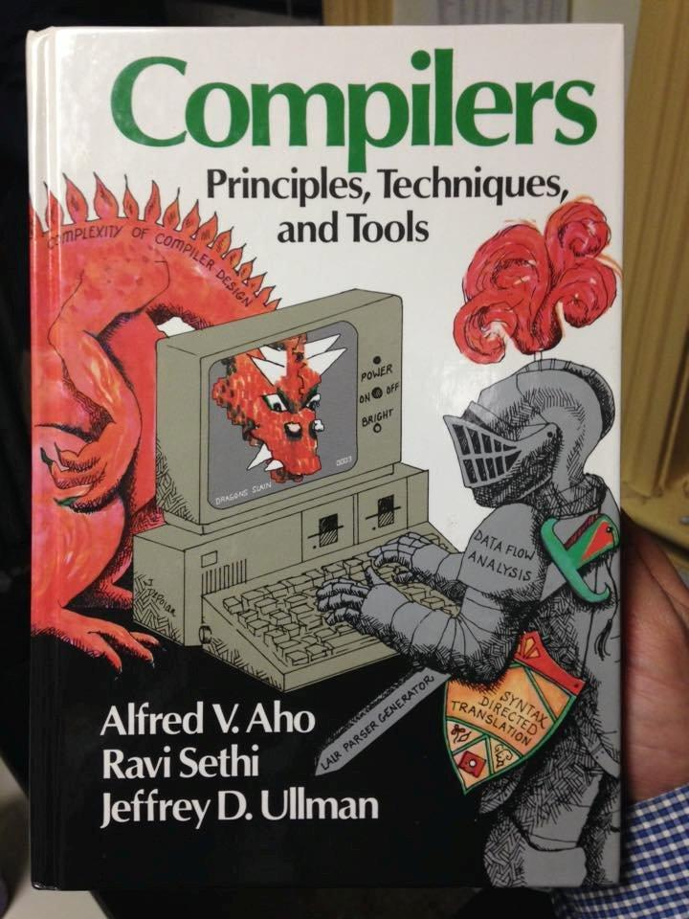
What’s a compiler anyway?
Compiler
Program
Program’
Just another software which takes some “data” in and produces “data” out. Turns out the “data” is itself a program, which makes the compiler “meta” somehow
“Pure”: (compilers a often written in functional languages)
No I/O, easy to keep stateless
Deterministic
Sequential (in general): no race bugs
Easy to test
=> Compilers are easy!

Slide 6
Why a compiler
Compiler
Program
Program’
Program’ is “similar” to the original Program, what changed?
Program may be textual representation and Program’ executable? (but this is the case for an “assembler” as well, is the “assembler” a compiler?)
Program’ may be source in another language? (Python-to-C++?)
Program’ may be “faster”?
Program’ may be “instrumented”?
Program’ may be using an accelerator?
…

Slide 7
What’s a program?
According to ChatGPT:
A program, in the context of computing, is a set of instructions that a computer can execute to perform a specific task or function. It consists of a sequence of commands or statements written in a programming language, which the computer's processor can understand and execute.

Slide 8
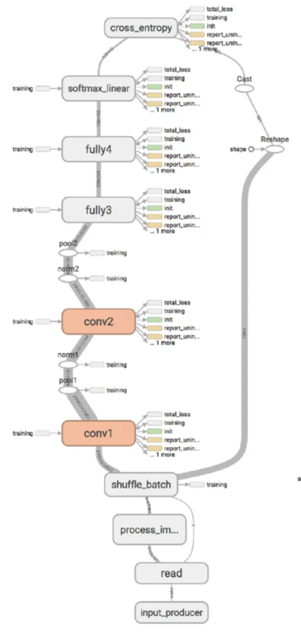
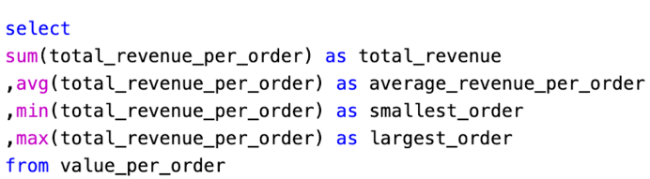
What’s a program?
According to ChatGPT:
A program, in the context of computing, is a set of instructions that a computer can execute to perform a specific task or function. It consists of a sequence of commands or statements written in a programming language, which the computer's processor can understand and execute.

Slide 9
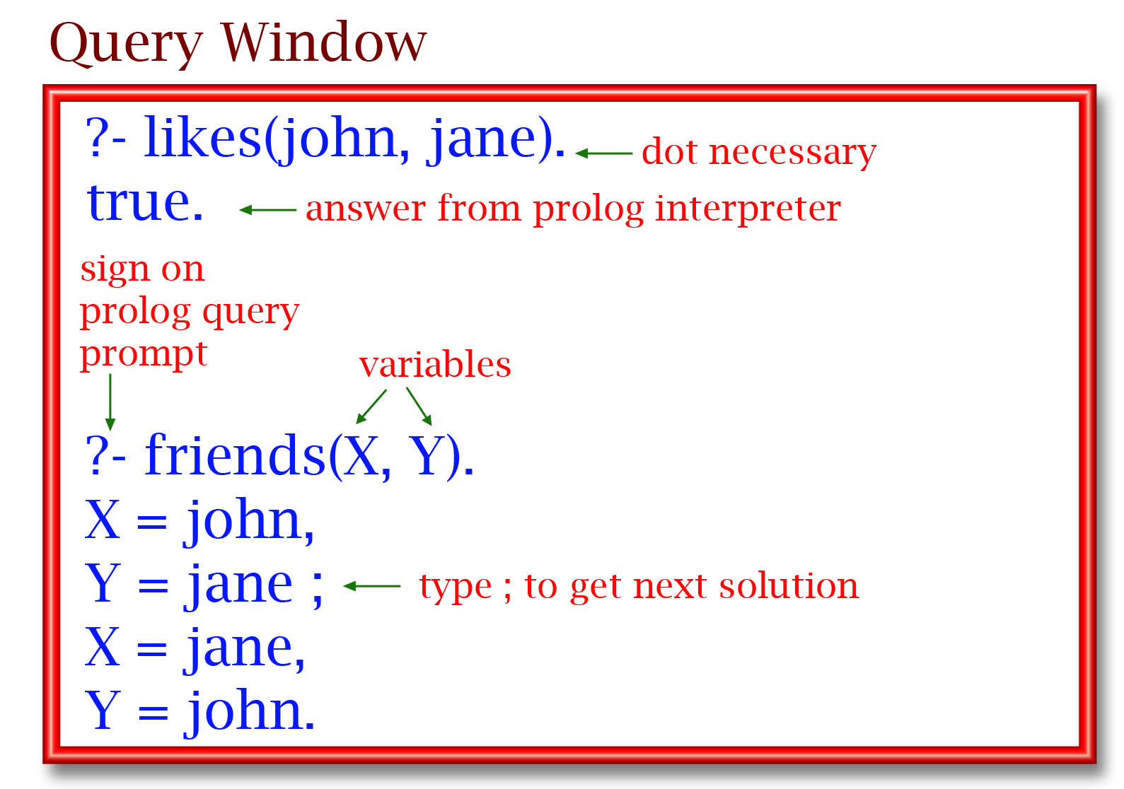
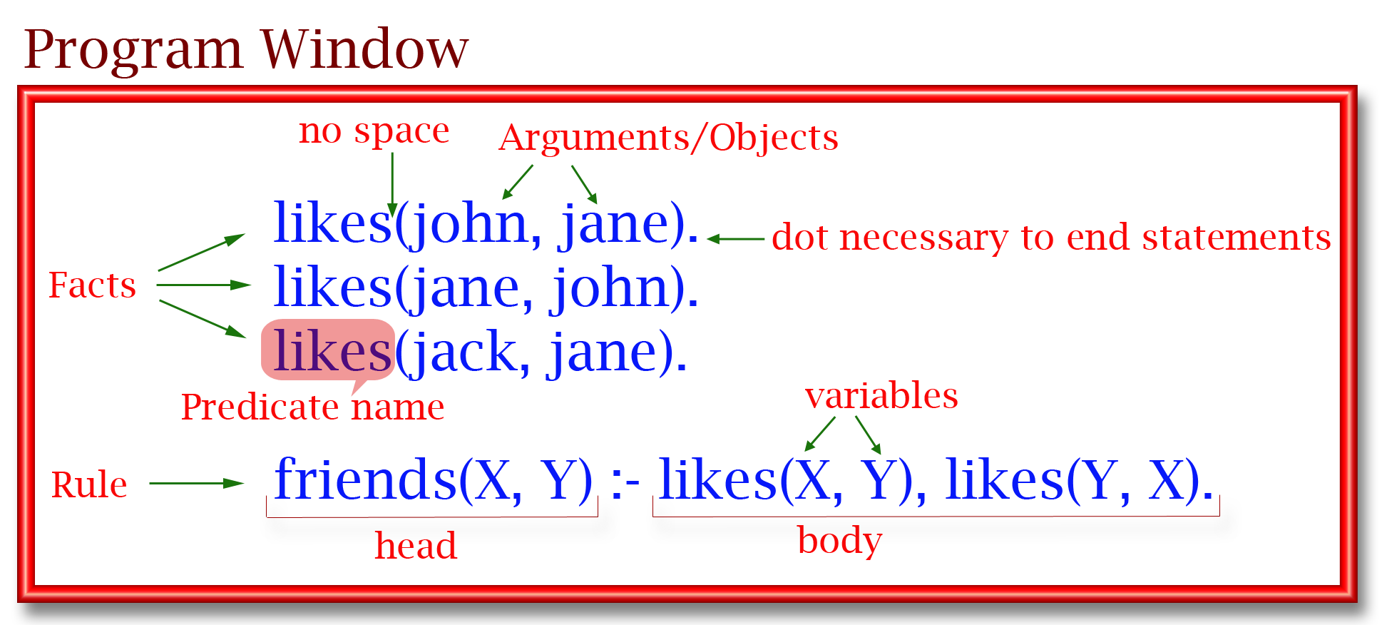
What’s a program?
According to ChatGPT:
A program, in the context of computing, is a set of instructions that a computer can execute to perform a specific task or function. It consists of a sequence of commands or statements written in a programming language, which the computer's processor can understand and execute.

Slide 10
What’s a program?
Lexical Analyzer
Stream of Tokens
According to ChatGPT:
A program, in the context of computing, is a set of instructions that a computer can execute to perform a specific task or function. It consists of a sequence of commands or statements written in a programming language, which the computer's processor can understand and execute.
Syntax Analyzer
Abstract Syntax Tree
Semantic Analyzer
Abstract Syntax Tree
IR Emitter
Intermediate
Representation (IR)
Optimizer
Optimized IR
Code Generation
(Virtual) ISA (or Bytecode)

Slide 11
What’s a program?
Lexical Analyzer
Stream of Tokens
According to ChatGPT:
A program, in the context of computing, is a set of instructions that a computer can execute to perform a specific task or function. It consists of a sequence of commands or statements written in a programming language, which the computer's processor can understand and execute.
Syntax Analyzer
Abstract Syntax Tree
Semantic Analyzer
Abstract Syntax Tree
IR Emitter
Intermediate
Representation (IR)
Different representations of the same program!
Optimizer
Optimized IR
Code Generation
(Virtual) ISA (or Bytecode)

Slide 12
Frontend of the compiler
Main role: from text to a structured representation.
Grammar
Type system
Diagnostics
Operates on “AST”: faithful structure, not easy to transform!
Lexical Analyzer
Stream of Tokens
Syntax Analyzer
Abstract Syntax Tree
Semantic Analyzer
Abstract Syntax Tree
IR Emitter
Intermediate
Representation (IR)
Optimizer
Optimized IR
Code Generation
(Virtual) ISA (or Bytecode)

Slide 13
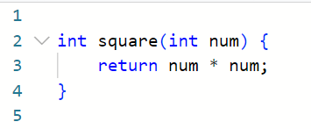
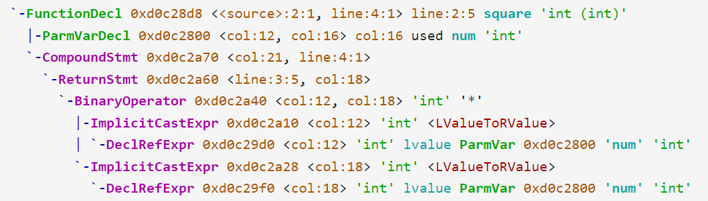
Frontend of the compiler
Main role: from text to a structured representation.
Grammar
Type system
Diagnostics
Operates on “AST”: faithful structure, not easy to transform!
Lexical Analyzer
Stream of Tokens
Syntax Analyzer
Abstract Syntax Tree
Semantic Analyzer
clang -Xclang -ast-dump
Abstract Syntax Tree
IR Emitter
Intermediate
Representation (IR)
Optimizer
Optimized IR
Code Generation
https://godbolt.org/z/1br84hxdK
(Virtual) ISA (or Bytecode)

Slide 14
Frontend of the compiler
Main role: from text to a structured representation.
Grammar
Type system
Diagnostics
Operates on “AST”: faithful structure, not easy to transform!
Lexical Analyzer
Stream of Tokens
Syntax Analyzer
Abstract Syntax Tree
Semantic Analyzer
“Middle-end” of the compiler
Transform the program, usually to “optimize”
Operates on IR: designed for analysis and transformations, does not contains “source” information like the AST.
Abstract Syntax Tree
IR Emitter
Intermediate
Representation (IR)
Optimizer
Optimized IR
Code Generation
(Virtual) ISA (or Bytecode)

Slide 15
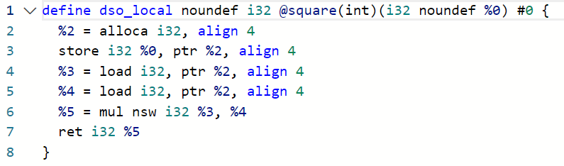
Lexical Analyzer
Stream of Tokens
Syntax Analyzer
Abstract Syntax Tree
Semantic Analyzer
“Middle-end” of the compiler
Transform the program, usually to “optimize”
Operates on IR: designed for analysis and transformations, does not contains “source” information like the AST.
Abstract Syntax Tree
IR Emitter
Intermediate
Representation (IR)
clang -emit-llvm -S -o -
Optimizer
Optimized IR
Code Generation
(Virtual) ISA (or Bytecode)

Slide 16
Frontend of the compiler
Main role: from text to a structured representation.
Grammar
Type system
Diagnostics
Operates on “AST”: faithful structure, not easy to transform!
Lexical Analyzer
Stream of Tokens
Syntax Analyzer
Abstract Syntax Tree
Semantic Analyzer
“Middle-end” of the compiler
Transform the program, usually to “optimize”
Operates on IR: designed for analysis and transformations, does not contains “source” information like the AST.
Abstract Syntax Tree
IR Emitter
Intermediate
Representation (IR)
Optimizer
Optimized IR
“Backend” of the compiler
From IR to “ISA”: select the available instruction on the target.
Code Generation
(Virtual) ISA (or Bytecode)

Slide 17
Frontend of the compiler
Main role: from text to a structured representation.
Grammar
Type system
Diagnostics
Operates on “AST”: faithful structure, not easy to transform!
Lexical Analyzer
Stream of Tokens
Syntax Analyzer
Abstract Syntax Tree
Semantic Analyzer
“Middle-end” of the compiler
Transform the program, usually to “optimize”
Operates on IR: designed for analysis and transformations, does not contains “source” information like the AST.
Abstract Syntax Tree
IR Emitter
Intermediate
Representation (IR)
Optimizer
Optimized IR
“Backend” of the compiler
From IR to “ISA”: select the available instruction on the target.
Code Generation
(Virtual) ISA (or Bytecode)

Slide 18
Modern languages pervasively invest in high level IRs
C, C++, ObjC, CUDA, OpenCL, ...
Clang AST
CIR IR
Swift
Swift AST
SIL IR
Rust
Rust AST
MIR IR
LLVM IR
...
Julia
Julia AST
Julia IR
Fortran
Flang AST
FIR IR
Language specific optimizations
Dataflow driven type checking - e.g. definitive initialization, borrow checker
Progressive lowering from high level abstractions
Notes:
It turns out that if you look across the ecosystem, this is a pervasive problem: each compiler frontend is creating one or more high level IR in addition to their AST representations! This leads to even more duplication across the industry.

Slide 19
Compiler Stack
High-Level Intermediate
Representation (IR)
High-Level Optimizer
Optimized HLIR
Progressive “lowering” of the abstraction level: different kind of optimizations at each level.
Lowering
Middle-level IR
Mid-Level Optimizer
To some extent, each level is the “backend” for the previous level, and the “frontend” for the next level.
Optimized Middle-level IR
Lowering
Low-level IR
Low-Level Optimizer
Optimized Low-level IR
Lowering

Slide 20
Compiler Passes
The program represented with the IR goes through a “pipeline” of passes (e.g. “loop unrolling”, “common subexpressions elimination”, “dead-store elimination”, “inlining”, …)
Optimizer
Analysis
Analysis
Analysis
IR
Pass 1
IR
Pass 2
IR
Pass 3
IR
Pass 4
IR
Natural granularity for testing!

Slide 21
Compiler Passes:
clang -emit-llvm -O3 -mllvm -print-pipeline-passes
annotation2metadata,forceattrs,declare-to-assign,inferattrs,coro-early,function<eager-inv>(lower-expect,simplifycfg<bonus-inst-threshold=1;no-forward-switch-cond;no-switch-range-to-icmp;no-switch-to-lookup;keep-loops;no-hoist-common-insts;no-sink-common-insts;speculate-blocks;simplify-cond-branch>,sroa<modify-cfg>,early-cse<>,callsite-splitting),openmp-opt,ipsccp,called-value-propagation,globalopt,function<eager-inv>(mem2reg,instcombine<max-iterations=1;no-use-loop-info;no-verify-fixpoint>,simplifycfg<bonus-inst-threshold=1;no-forward-switch-cond;switch-range-to-icmp;no-switch-to-lookup;keep-loops;no-hoist-common-insts;no-sink-common-insts;speculate-blocks;simplify-cond-branch>),always-inline,require<globals-aa>,function(invalidate<aa>),require<profile-summary>,cgscc(devirt<4>(inline,function-attrs<skip-non-recursive-function-attrs>,argpromotion,openmp-opt-cgscc,function<eager-inv;no-rerun>(sroa<modify-cfg>,early-cse<memssa>,speculative-execution<only-if-divergent-target>,jump-threading,correlated-propagation,simplifycfg<bonus-inst-threshold=1;no-forward-switch-cond;switch-range-to-icmp;no-switch-to-lookup;keep-loops;no-hoist-common-insts;no-sink-common-insts;speculate-blocks;simplify-cond-branch>,instcombine<max-iterations=1;no-use-loop-info;no-verify-fixpoint>,aggressive-instcombine,libcalls-shrinkwrap,tailcallelim,simplifycfg<bonus-inst-threshold=1;no-forward-switch-cond;switch-range-to-icmp;no-switch-to-lookup;keep-loops;no-hoist-common-insts;no-sink-common-insts;speculate-blocks;simplify-cond-branch>,reassociate,constraint-elimination,loop-mssa(loop-instsimplify,loop-simplifycfg,licm<no-allowspeculation>,loop-rotate<header-duplication;no-prepare-for-lto>,licm<allowspeculation>,simple-loop-unswitch<nontrivial;trivial>),simplifycfg<bonus-inst-threshold=1;no-forward-switch-cond;switch-range-to-icmp;no-switch-to-lookup;keep-loops;no-hoist-common-insts;no-sink-common-insts;speculate-blocks;simplify-cond-branch>,instcombine<max-iterations=1;no-use-loop-info;no-verify-fixpoint>,loop(loop-idiom,indvars,loop-deletion,loop-unroll-full),sroa<modify-cfg>,vector-combine,mldst-motion<no-split-footer-bb>,gvn<>,sccp,bdce,instcombine<max-iterations=1;no-use-loop-info;no-verify-fixpoint>,jump-threading,correlated-propagation,adce,memcpyopt,dse,move-auto-init,loop-mssa(licm<allowspeculation>),coro-elide,simplifycfg<bonus-inst-threshold=1;no-forward-switch-cond;switch-range-to-icmp;no-switch-to-lookup;keep-loops;hoist-common-insts;sink-common-insts;speculate-blocks;simplify-cond-branch>,instcombine<max-iterations=1;no-use-loop-info;no-verify-fixpoint>),function-attrs,function(require<should-not-run-function-passes>),coro-split)),deadargelim,coro-cleanup,globalopt,globaldce,elim-avail-extern,rpo-function-attrs,recompute-globalsaa,function<eager-inv>(float2int,lower-constant-intrinsics,chr,loop(loop-rotate<header-duplication;no-prepare-for-lto>,loop-deletion),loop-distribute,inject-tli-mappings,loop-vectorize<no-interleave-forced-only;no-vectorize-forced-only;>,infer-alignment,loop-load-elim,instcombine<max-iterations=1;no-use-loop-info;no-verify-fixpoint>,simplifycfg<bonus-inst-threshold=1;forward-switch-cond;switch-range-to-icmp;switch-to-lookup;no-keep-loops;hoist-common-insts;sink-common-insts;speculate-blocks;simplify-cond-branch>,slp-vectorizer,vector-combine,instcombine<max-iterations=1;no-use-loop-info;no-verify-fixpoint>,loop-unroll<O3>,transform-warning,sroa<preserve-cfg>,infer-alignment,instcombine<max-iterations=1;no-use-loop-info;no-verify-fixpoint>,loop-mssa(licm<allowspeculation>),alignment-from-assumptions,loop-sink,instsimplify,div-rem-pairs,tailcallelim,simplifycfg<bonus-inst-threshold=1;no-forward-switch-cond;switch-range-to-icmp;no-switch-to-lookup;keep-loops;no-hoist-common-insts;no-sink-common-insts;speculate-blocks;simplify-cond-branch>),globaldce,constmerge,cg-profile,rel-lookup-table-converter,function(annotation-remarks),print
Compiler returned: 0

Slide 22
OK, Compiler looks cool, but what’s MLIR?
Not a compiler, and definitely nothing to do with “ML”.
Framework to build a compiler IR: define your type system, operations, etc.
Toolbox covering your compiler infrastructure needs
Diagnostics, pass-management infrastructure, multi-threading, testing tools, etc.
Batteries-included:
Various code-generation components / lowering strategies
Tooling for accelerator support (GPUs)
Allow different levels of abstraction to freely co-exist
Abstractions can better target specific areas with less high-level information lost
Progressive lowering simplifies and enhances transformation pipelines
No arbitrary boundary of abstraction, e.g. host and device code in the same IR at the same time
LLVM-inspired

Slide 23
Underlying MLIR development
We “sell” a combination of:
Time to market: minimize the time “from idea to prototype”, easier transition for “research to production”
Allow you to focus on your value-add (do you want to reimplement everything?)
Flexibility: encourage modular design (dialect), allow you to adjust and re-iterate, resilient to initial mistakes.
Built for production from day-1: heavily optimized behind the scene. -> minimize the effort to go “from prototype to a product” Inspired by LLVM, fixing all the mistakes!
Modular: “you pay for what you use” footprint
CoreIR & builtin dialect & printer/parser & bytecode: 2MB
+ the pass infrastructure, instrumentation, etc.: 3MB (+1MB)
+ canonicalize, pattern/rewrite infra, PDL compiler/interpreter: 4.8MB (+1.8MB)
Standardize compiler infrastructure: don’t learn over and over the peculiarities of each compiler infrastructure. Learn MLIR and you can more easily learn about any MLIR-based compiler! (Translates into: good skill to have on your resume for engineer, easier hiring for companies)

Slide 24
Core MLIR Concepts

Slide 25
MLIR
Principles
Easy to manipulate, mapped to convenient APIs
IR Invariants constraints auto-verified
In-memory
IR
Roundtrip
Textual IR
Bytecode
Testing
Debugging
(call dump() on any MLIR entity)
Deployment
Versioning: forward/backward compat

Slide 26
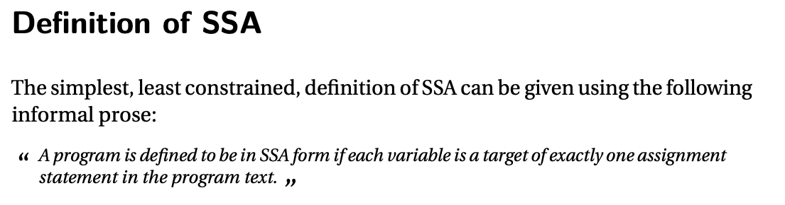
IR Core Concepts
https://pfalcon.github.io/ssabook/latest/book.pdf
Notes:
MLIR core concepts are fairly simple. The IR is organized around three main data structure:
Region: …
Block: …
Operation: …
The important part to remember is that there aren’t any hard-coded structure or operations in MLIR. Even the top-level Module and the definitions of Function are just modeled as any other operation.

Slide 27
IR Core Concepts
Very few core-defined aspects, MLIR is generic and favor extensibility:
Region, either:
a list of basic blocks chained through their terminators to form a CF
a single block containing operations forming a generic directed graph (including cyclic).
Block: a sequential list of Operations. They take arguments instead of using phi nodes.
Operation: a generic single unit of “code”.
takes individual Values as operands,
produces one or more SSA Values as results.
A terminator operation also has a list of successors blocks, as well as arguments matching the blocks.
There aren’t any hard-coded structures or specific operations in MLIR: even Module and Function are defined just as regular operations!
Wide range of applications: Dataflow Graphs, ML Compilers, HW Design, Parallel Optimization, Heterogeneous runtime, Functional programming, Fortran Compiler, Heterogeneous code generation, Encryption, Program analysis, Zero knowledge proof compilation, Quantum, Blockchain, …
Notes:
MLIR core concepts are fairly simple. The IR is organized around three main data structure:
Region: …
Block: …
Operation: …
The important part to remember is that there aren’t any hard-coded structure or operations in MLIR. Even the top-level Module and the definitions of Function are just modeled as any other operation.

Slide 28
Operations, Not Instructions
No predefined set of instructions
Operations are like “opaque functions” to MLIR
Number of
value returned
Dialect
prefix
Index in the producer’s results
List of properties: Compile-time data associated with an operation
Op Id
Argument
%res:2 = "mydialect.morph"(%input#3) <cute.layout = ((2, 4), _), other.attribute = ENUM_VAL>
{ some.attribute = true, other.attribute = 1.5 } : (!mydialect.buf<dtype = f32, strides =[1, 2]>) -> (!mydialect.buf<dtype = f32, strides =[1, 2]>, !mydialect.buf<dtype = f32, strides =[1, 2]>)
loc(callsite("foo" at "mysource.cc":10:8))
Discardable attributes dict: extra unbounded data that can be attached to any operation.
Name of the SSA results (mlir::Value)
Type informations
Mandatory and Rich Location
Dialect prefix for the type
https://mlir.llvm.org/docs/LangRef/#operations
https://github.com/llvm/llvm-project/blob/main/mlir/include/mlir/IR/Operation.h#L31-L84
Notes:
In MLIR, everything is about Operations, not Instructions: we put the emphasis to distinguish from the LLVM view. In LLVM you have a fixed list of instructions, which all are defined with their own class which defines members and storage. It isn’t the case in MLIR: there is one opaque C++ class and it defines the storage in a generic way for any possible operation.
Operations can be coarse grain (perform a matrix-multiplication, or launch a remote RPC task) or can directly carry loop nest or other kind of nested “regions”, we’ll show some examples later.
Let’s starts with the anatomy of an operation.
What you see on the screen with a lot of color is the generic assembly format for MLIR. Just like LLVM has a textual output, any MLIR operation can be represented in this generic format. This makes serialization and deserialization really simple.
So what are the elements that define an operation? There is an isomorphic relation between the in-memory representation and the generic format, let me walk you through this.
First, what uniquely identify an operation is its name, you have the operation ID, prefixed by the dialect name. Together this provides a unique name for an operation.
An operation produces SSA results. An LLVM instruction produces only one SSA value at most, in MLIR they can generate many. This operation for example defines 2 SSA value as results. The textual IR here uses a single name for the SSA value, and an index to differentiate the two values.
In parentheses, you have the list of operands for the operation. This is a comma-separated list of SSA values. You can see here the name of the SSA value but also an optional index. Here we’ll use the fourth result of the operation producing the “%input” result.
After the list of operands is a dictionary of Attributes, which can be seen as extras operands with are restricted to be constant literal values, they can’t refer to other SSA value.
On the second line is the type of the operation. We’re using a functional notation, so after the colon you have the types of the operands in parenthesis.
The type after the bang is the name of a dialect, followed in angle brackets by the custom serialization of the type defined by the dialect, it is opaque to MLIR. After the arrow is the type for the results, here this operation defines two results so we have two types.
Finally on the last line is the location for the operation. We often elide it from the debug print, but it is always present in memory. Locations are rich: here we can represent that it corresponds to a particular call site of a function at a given place in the source.
Alright this what an Operation is made for, and something to keep in mind is that when you define an operation you really can’t add more state or storage to an operation. When you define an operation in MLIR you just actually put restriction on what is valid for the operation: for example can it return a result? Multiple? What are the restrictions on the types? What attributes are allowed? Actually there is one more thing though, let’s look at regions.

Slide 29
Hands-on: ir-traversal
Let’s work through the second hands on.

Slide 30
Recursive nesting: Operations -> Regions -> Blocks
%results:2 = "d.operation"() ({
// Regions belong to Ops and can have multiple blocks.
^block(%argument: !d.type):
%value = "nested.operation"() ({
// Ops can contain nested regions.
"d.op"() : () -> ()
}) : () -> (!d.other_type)
"consume.value"(%value) : (!d.other_type) -> ()
^other_block:
"d.terminator"() [^block(%arg0 : !d.type)] : () -> ()
}) : () -> (!d.type, !d.other_type)
Region
Block
Region
Regions are list of basic blocks nested inside of an operation.
Basic blocks are a list of operations: the IR structure is recursively nested!
Conceptually similar to function call, but can reference SSA values defined outside.
SSA values defined inside don’t escape.
https://mlir.llvm.org/docs/Tutorials/UnderstandingTheIRStructure/
https://mlir.llvm.org/docs/LangRef/#high-level-structure
Notes:
On top of the previous introduced element, another important property of an operation is that it can hold a list of “region”. The concept of region does not have an equivalent in LLVM IR. The best analogy is to look at LLVM functions, these are first class structure in LLVM which hold a body in the form of a CFG. The CFG is a control flow graph which is hold as chained list of basic blocks. In MLIR, everything is an operation: even a function is an operation. Operations optionally have one or multiple regions attached, and a region is nothing else than a list of blocks which may represent a CFG. This is how functions are modelled in MLIR: an operation with a region that models the body of the function.
Since a region is a list of basic blocks, which themselves are a list of operations: the structure is recursively nested! This is a whole new dimension in the IR which opens up design possibilities. Regions are commonly used in MLIR and very powerful to express the structure of the IR, we’ll come back to this with multiple examples.
And with this simple structure you can understand almost everything in MLIR.

Slide 31
Regions
Graph Regions
func.func @hello(%arg0 : i32, %arg1 : i1) {
…
…
}
scf.if (%arg1) {
…
} else {
…
}
“CFG Regions”: sequential list of operations, the control flows from one operation to the next in order (similar to LLVM)
my.graph @hello(%arg0 : i32, %arg1 : i1) {
… B_user(%b) : …
…
%b = B_producer(%c) : …
…
%c = C_producer(%b) : …
}
“Graph Regions”: single block with unordered list of operations and no terminator requirement.
Cycles in SSA def-use are also allowed!
-> ML Dataflow Graphs -> “Circuit level” logic -> Synchronous domain …
Future Extension to Region: Multiple-Entry, Multiple-Exit MLIR Regions
EuroLLVM 2023: slides and recording

Slide 32
Hands-on: ir-traversal-with-regions

Slide 33
Dialects: Defining Rules and Semantics for the IR
A MLIR dialect is a logical grouping including:
A prefix (“namespace” reservation)
A list of custom types, each its C++ class.
A list of operations, each its name and C++ class implementation:
Verifier for operation invariants (e.g. toy.print must have a single operand)
Semantics (has-no-side-effects, constant-folding, CSE-allowed, ….)
Passes: analysis, transformations, and dialect conversions.
Possibly custom parser and assembly printer
Dialects co-exist: a program is often represent by a mix of dialects!
https://mlir.llvm.org/docs/LangRef/#dialects
https://github.com/llvm/llvm-project/blob/master/mlir/include/mlir/IR/Dialect.h#L37
https://mlir.llvm.org/docs/Tutorials/CreatingADialect/
Notes:
You will hear a lot about “Dialects“ in the MLIR ecosystem. A Dialect is a bit like a C++ library: it is at minima a namespace where you can group a set of types, a set of operations that operate on these types (or types defined by other dialects), and a set of custom attributes. So just like a C++ library where you define classes, methods, etc. The Dialect is your own IR library: by defining this set of types/attributes/operations you can define a closed set that has a well defined semantics that you can manipulate.
A dialect is loaded inside the MLIRContext and extends MLIR using various hooks, like for example to the IR verifier: it will enforce invariants on the IR (just like the LLVM verifier).
Dialects are cheap abstraction: you create one like you create a new C++ library. There are roughly 20 dialects that come bundled with MLIR, but many more have been defined by MLIR users: our internal users at Google have defined over 60 so far!
Something else that is important to know before looking at examples of MLIR, is that the IR does not always look like the generic format we’ve seen previously. This is because Dialect authors can also customize the printing/parsing of Operations and Types to make the IR more readable. Dialect IR are more like DSLs: you may need to read the documentation to interpret them correctly. You can always disable the custom printing and have a generic print of the IR though.

Slide 34
LLVM as a dialect
%13 = llvm.alloca %arg0 x !llvm.double : (!llvm.i32) -> !llvm.ptr<double>
%14 = llvm.getelementptr %13[%arg0, %arg0]
: (!llvm.ptr<double>, !llvm.i32, !llvm.i32) -> !llvm.ptr<double>
%15 = llvm.load %14 : !llvm.ptr<double>
llvm.store %15, %13 : !llvm.ptr<double>
%16 = llvm.bitcast %13 : !llvm.ptr<double> to !llvm.ptr<i64>
%17 = llvm.call @foo(%arg0) : (!llvm.i32) -> !llvm.struct<(i32, double, i32)>
%18 = llvm.extractvalue %17[0] : !llvm.struct<(i32, double, i32)>
%19 = llvm.insertvalue %18, %17[2] : !llvm.struct<(i32, double, i32)>
%20 = llvm.constant(@foo : (!llvm.i32) -> !llvm.struct<(i32, double, i32)>) :
!llvm.ptr<func<struct<i32, double, i32> (i32)>>
%21 = llvm.call %20(%arg0) : (!llvm.i32) -> !llvm.struct<(i32, double, i32)>
More intro to MLIR: https://mlir.llvm.org/docs/Tutorials/Toy/
Notes:
Another example of a dialect with a custom printer is the LLVM IR itself. Indeed the LLVM IR can be modeled as a dialect, and actually is implemented in MLIR!
You’ll find the LLVM instructions and types, prefixed with the `llvm.` dialect namespace.
The LLVM dialect isn’t feature-complete (inline assembly, block addresses, …), but defines enough of LLVM to support the common need of DSL-oriented codegen.
There are also some minor deviation from LLVM IR: for example because of MLIR structure, constants aren’t special and are instead modeled as regular operations.
For more details into the MLIR infrastructure, feel free to lookup the website for documentation, and in particular the Toy tutorial which can walk you through a practical example.

Slide 35
I love it: how do I start to write my dialect?
So you want to design an IR: it’s a bit of an art, but not very different from other API design.
Start with the type system:
what are the objects you want to model?
Are you manipulating “arrays”? Scalars?
Are they mutable?
Then the operations:
Very dependent on the type modeling: if mutable, think about side-effects. dot(%a, %b, %c) vs %c = dot(%a, %b)
Control-flow: imperative programing model or dataflow graph?
https://mlir.llvm.org/docs/DefiningDialects/#defining-a-dialect

Slide 36
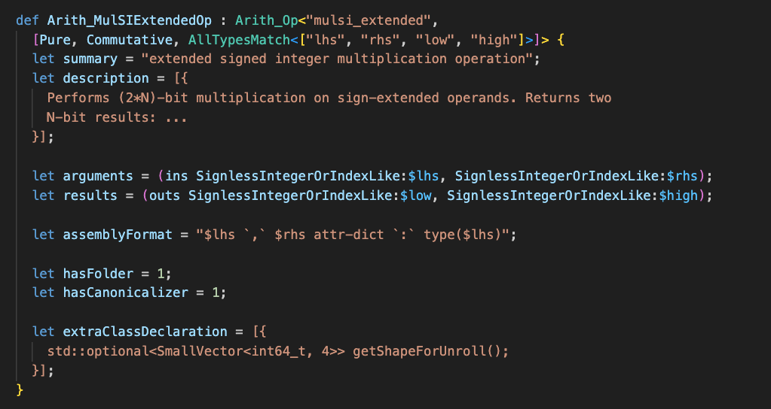
ODS: Operation Definition Specification
https://mlir.llvm.org/docs/DefiningDialects/Operations/
https://mlir.llvm.org/docs/Dialects/ArithOps/#arithmulsi_extended-arithmulsiextendedop

Slide 37
ODS: Operation Definition Specification
https://mlir.llvm.org/docs/DefiningDialects/Operations/
https://mlir.llvm.org/docs/Dialects/ArithOps/#arithmulsi_extended-arithmulsiextendedop

Slide 38
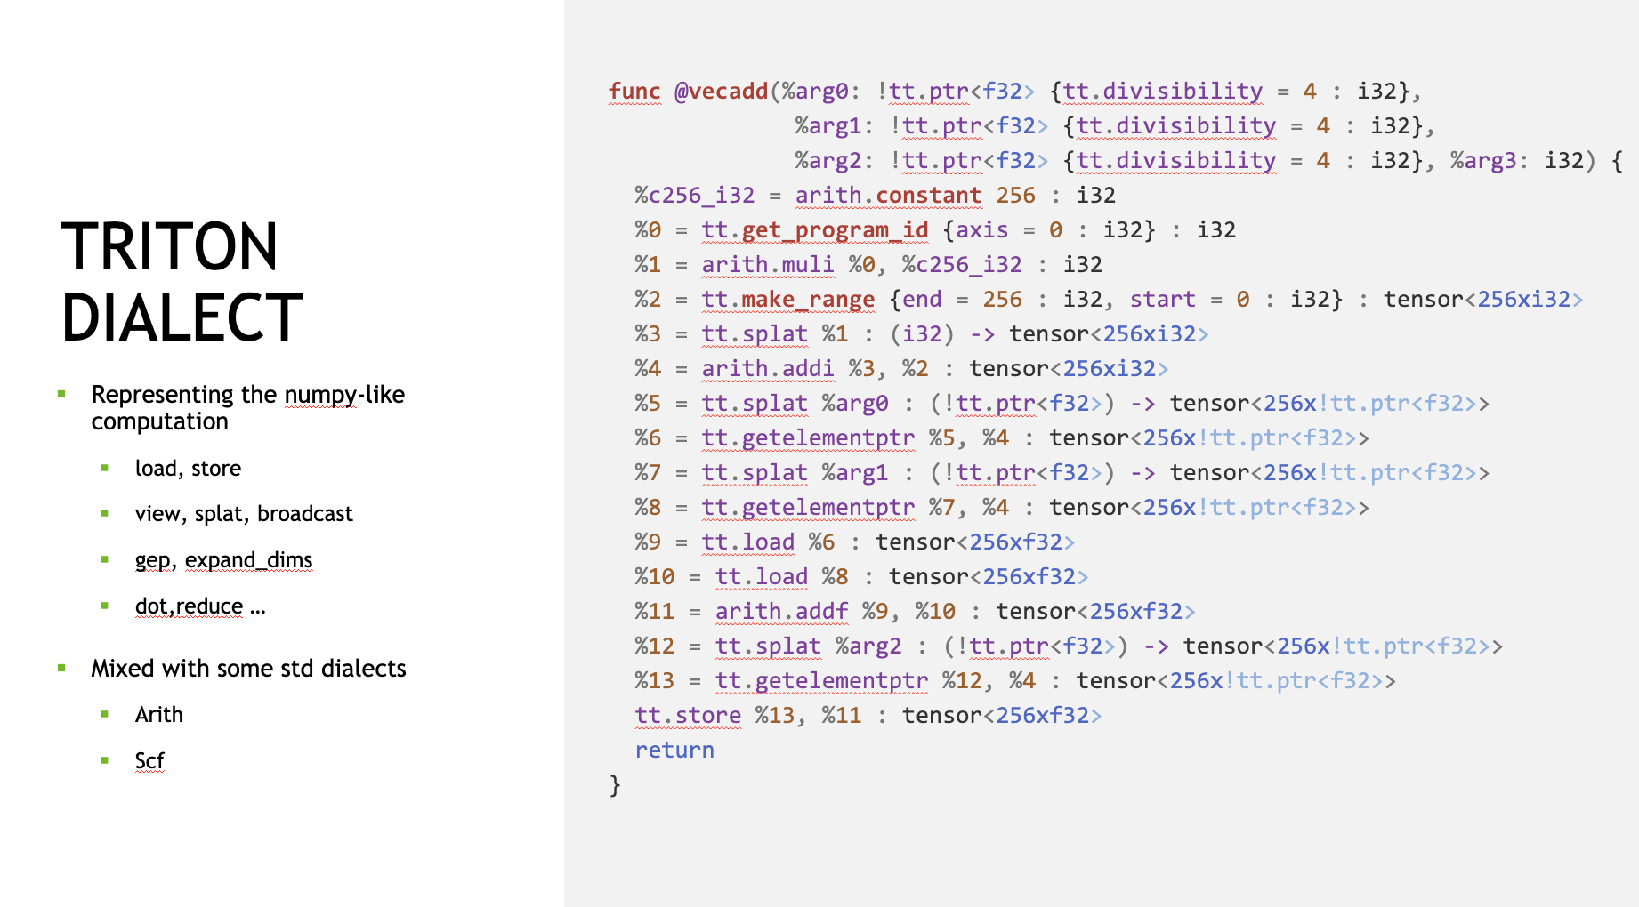


Slide 39
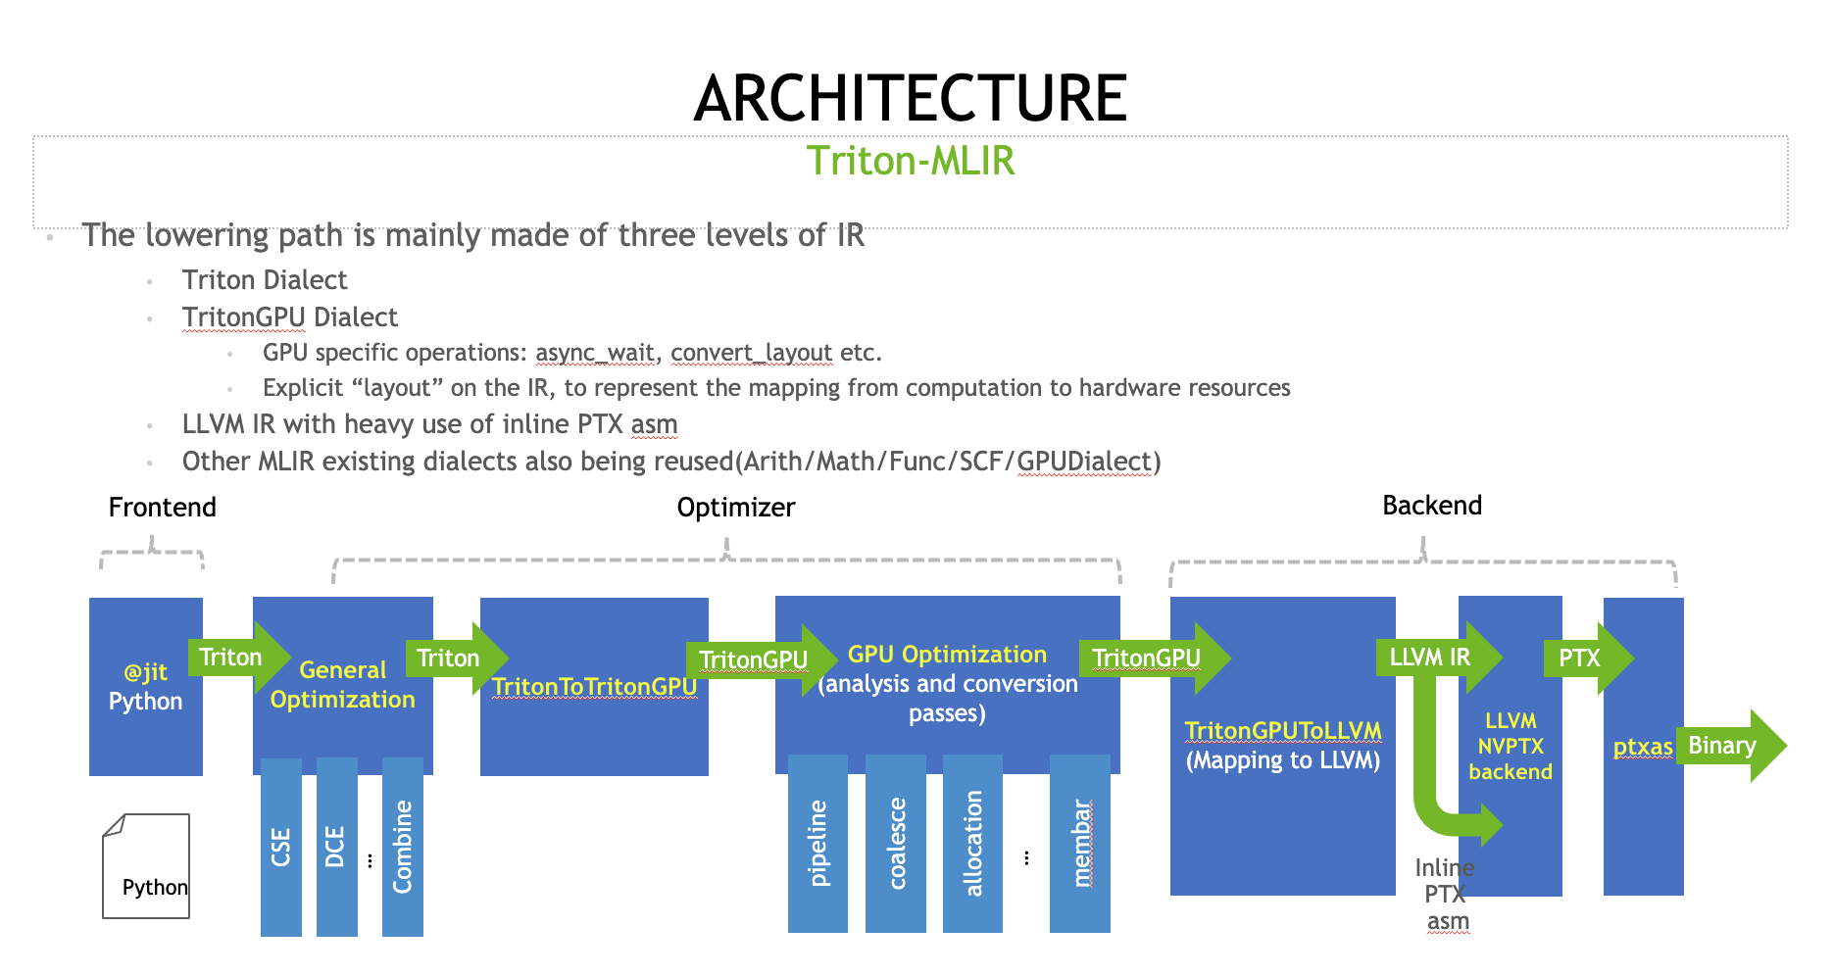

Slide 40
I have a dialect now, how do I test it?
The program represented with the IR goes through a “pipeline” of passes (e.g. “loop unrolling”, “common subexpressions elimination”, “dead-store elimination”, “inlining”, …)
IR
Pass 1
IR
Pass 2
IR
Pass 3
IR
Pass 4
IR
Conventions in MLIR/LLVM:
`*-opt` command line tool: https://mlir.llvm.org/docs/Tutorials/MlirOpt/
FileCheck” test: https://github.com/llvm/llvm-project/blob/main/mlir/test/Transforms/canonicalize.mlir#L1
IR is “verified” for invariant between each pass: a pass assumes valid IR input and produces valid IR output.
annotation2metadata,forceattrs,declare-to-assign,inferattrs,coro-early,function<eager-inv>(lower-expect,simplifycfg<bonus-inst-threshold=1;no-forward-switch-cond;no-switch-range-to-icmp;no-switch-to-lookup;keep-loops;no-hoist-common-insts;no-sink-common-insts;speculate-blocks;simplify-cond-branch>,sroa<modify-cfg>,early-cse<>,callsite-splitting),openmp-opt,ipsccp,called-value-propagation,globalopt,function<eager-inv>(mem2reg,instcombine<max-iterations=1;no-use-loop-info;no-verify-fixpoint>,simplifycfg<bonus-inst-threshold=1;no-forward-switch-cond;switch-range-to-icmp;no-switch-to-lookup;keep-loops;no-hoist-common-insts;no-sink-common-insts;speculate-blocks;simplify-cond-branch>),always-inline,require<globals-aa>,function(invalidate<aa>),require<profile-summary>,cgscc(devirt<4>(inline,function-attrs<skip-non-recursive-function-attrs>,argpromotion,openmp-opt-cgscc,function<eager-inv;no-rerun>(sroa<modify-cfg>,early-cse<memssa>,speculative-execution<only-if-divergent-target>,jump-threading,correlated-propagation,simplifycfg<bonus-inst-threshold=1;no-forward-switch-cond;switch-range-to-icmp;no-switch-to-lookup;keep-loops;no-hoist-common-insts;no-sink-common-insts;speculate-blocks;simplify-cond-branch>,instcombine<max-iterations=1;no-use-loop-info;no-verify-fixpoint>,aggressive-instcombine,libcalls-shrinkwrap,tailcallelim,simplifycfg<bonus-inst-threshold=1;no-forward-switch-cond;switch-range-to-icmp;no-switch-to-lookup;keep-loops;no-hoist-common-insts;no-sink-common-insts;speculate-blocks;simplify-cond-branch>,reassociate,constraint-elimination,loop-mssa(loop-instsimplify,loop-simplifycfg,licm<no-allowspeculation>,loop-rotate<header-duplication;no-prepare-for-lto>,licm<allowspeculation>,simple-loop-unswitch<nontrivial;trivial>),simplifycfg<bonus-inst-threshold=1;no-forward-switch-cond;switch-range-to-icmp;no-switch-to-lookup;keep-loops;no-hoist-common-insts;no-sink-common-insts;speculate-blocks;simplify-cond-branch>,instcombine<max-iterations=1;no-use-loop-info;no-verify-fixpoint>,loop(loop-idiom,indvars,loop-deletion,loop-unroll-full),sroa<modify-cfg>,vector-combine,mldst-motion<no-split-footer-bb>,gvn<>,sccp,bdce,instcombine<max-iterations=1;no-use-loop-info;no-verify-fixpoint>,jump-threading,correlated-propagation,adce,memcpyopt,dse,move-auto-init,loop-mssa(licm<allowspeculation>),coro-elide,simplifycfg<bonus-inst-threshold=1;no-forward-switch-cond;switch-range-to-icmp;no-switch-to-lookup;keep-loops;hoist-common-insts;sink-common-insts;speculate-blocks;simplify-cond-branch>,instcombine<max-iterations=1;no-use-loop-info;no-verify-fixpoint>),function-attrs,function(require<should-not-run-function-passes>),coro-split)),deadargelim,coro-cleanup,globalopt,globaldce,elim-avail-extern,rpo-function-attrs,recompute-globalsaa,function<eager-inv>(float2int,lower-constant-intrinsics,chr,loop(loop-rotate<header-duplication;no-prepare-for-lto>,loop-deletion),loop-distribute,inject-tli-mappings,loop-vectorize<no-interleave-forced-only;no-vectorize-forced-only;>,infer-alignment,loop-load-elim,instcombine<max-iterations=1;no-use-loop-info;no-verify-fixpoint>,simplifycfg<bonus-inst-threshold=1;forward-switch-cond;switch-range-to-icmp;switch-to-lookup;no-keep-loops;hoist-common-insts;sink-common-insts;speculate-blocks;simplify-cond-branch>,slp-vectorizer,vector-combine,instcombine<max-iterations=1;no-use-loop-info;no-verify-fixpoint>,loop-unroll<O3>,transform-warning,sroa<preserve-cfg>,infer-alignment,instcombine<max-iterations=1;no-use-loop-info;no-verify-fixpoint>,loop-mssa(licm<allowspeculation>),alignment-from-assumptions,loop-sink,instsimplify,div-rem-pairs,tailcallelim,simplifycfg<bonus-inst-threshold=1;no-forward-switch-cond;switch-range-to-icmp;no-switch-to-lookup;keep-loops;no-hoist-common-insts;no-sink-common-insts;speculate-blocks;simplify-cond-branch>),globaldce,constmerge,cg-profile,rel-lookup-table-converter,function(annotation-remarks),print
Compiler returned: 0

Slide 41
Hands-on: let’s play with a pass
C++ entities & ownership model
Play with the scheduling
Debugging/logging API
Let’s do IR mutation
Diagnostics and remarks
MLIR has a somehow unusual model:
The MLIRContext (like in LLVM) holds some immutable entities for the duration of its existence: Attributes and Types (as such: the MLIRContext must always outlive your IR)
Many classes are actually thin wrapper around a pointer:
Concrete Ops, Types, and Attributes
Ops add “convenient” / “type safe” APIs on top of the raw pointer they encapsulate.
Passed by value everywhere: it’s just a reference-class, always the size of a pointer.
Ownership of operations is their parent
Top-level operation (or orphan ones) should be owned in RAII class (mlir::OwningOpRef)

Slide 42
In the box…
IR (including serialization/deserialization to text and bytecode)
Pass Manager
Dialect Conversion Framework
PDL/PDLL: bytecode for dynamic loading of pattern/matching logic.
Transform Dialect: schedule and control transformation (underlying infrastructure for a Halide-like tool)
DataFlow engine (forward, backward, bi-directional): EuroLLVM 2023 slides and recording
IR Reduction tool
Tracing / Debugging infra (“compiler fuel”, bisection, etc.) doc, slides and recording
Python Bindings (documentation)
EmitC: generating source code (C, C++, Cuda, OpenCL, …) (documentation)…
…
“Batteries included”:
Tensor Abstractions
Hyper-rectangular code generation
Affine/Polyhedral code generation
Presburger arithmetic library
Sparse tensors (TACO)
GPU code generation infrastructure support
Multi-dimensional Vector abstractions.
OpenMP/OpenACC
…
Targeting:
Fast prototypes / experiments
Research
Teaching
Production compilers

Slide 43

Resources
Online doc and tutorials: https://mlir.llvm.org/
GitHub: https://github.com/llvm/llvm-project/tree/main/mlir
Discord (~Slack) https://discord.gg/upPwxtwA
Discourse Forum: https://discourse.llvm.org/c/mlir/31
Previous tech talks: https://mlir.llvm.org/talks/
LLVM Conferences: https://www.youtube.com/@LLVMPROJ/search?query=MLIR

